Slide 1
Introduction
Worked on Tornado (1950-2015) dataset.
It contains data with two different measures
  Fujita scale (1950 to 1995)
  Enhanced Fujita Scale(1995-2015)
The goal is to predict the magnitude of the Tornado based on the F-scale rating
Major points in Data pre-processing
  Performed interpolation to fill the missing cells.
  Combined Property Loss and Crop Loss as Total Loss.
  Combined Injuries and Fatalities as Human Loss.
  Modified each column such that they have same format.
Algorithms applied
  Decision Tree
  Neural network
  Naïve Bayes
Notes:
Author: Hruday Kumar Voruganti
USC ID: 5894004587
Email: vorugant@usc.edu
Team : alladi@usc.edu, kadaikal@usc.edu, voruganti@usc.edu
References:
Wolfram Research, "Tornadoes in the U.S., 1950-2015" from the Wolfram Data Repository. (2016) https://doi.org/10.24097/wolfram.33875.data
Decision Tree adopted from the following link: https://github.com/antononcube/MathematicaForPrediction/blob/master/AVCDecisionTreeForest.m

Slide 2
Algorithms
DECISION TREE | NEURAL NETWORK | NAÏVE BAYES
Decision trees are one of the major Machine Learning algorithms utilized to classify the data based on flow-chart like structure. Utilized AVCDecisionTree to implement the classification on the dataset. The algorithm forms nodes with each label at every level and makes a decision in that stage. | Neural networks are the algorithms inspired from the biological system. They learn about the things in layers. At each node, it utilizes threshold value to move to the next layer of learning We utilized the method “Neural Networks” available in the Classify function to apply on the training dataset. | Naïve Bayes is one of the basic algorithm useful for multi-class classification. It utilizes conditional probability to decide the class of the data. Naïve Bayes classifiers are highly scalable. It utilizes the property “Maximum-Likelihood” to decide the class of newly arrived data. It was chosen as it has very less chances of overfitting.

Slide 3
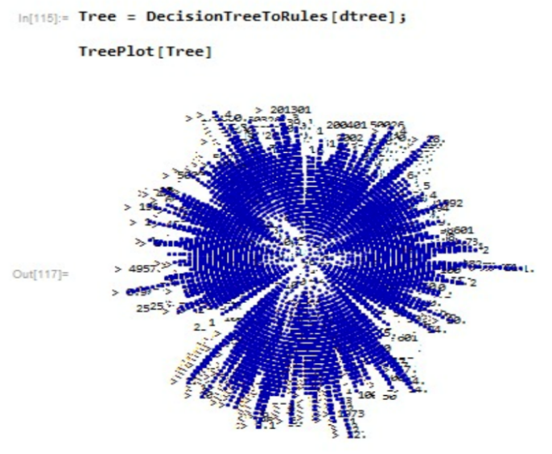
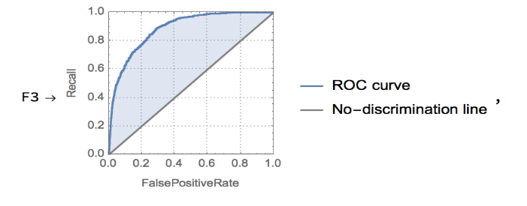
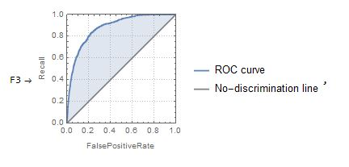
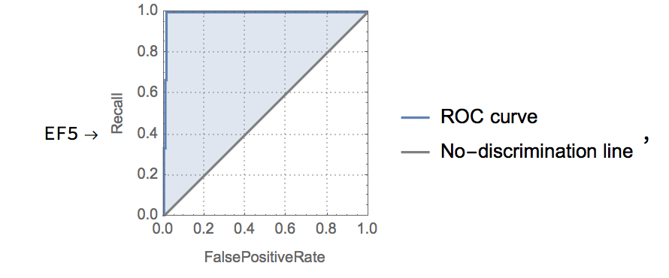
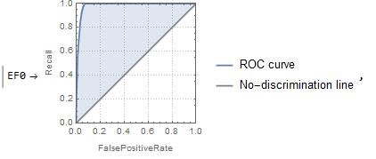
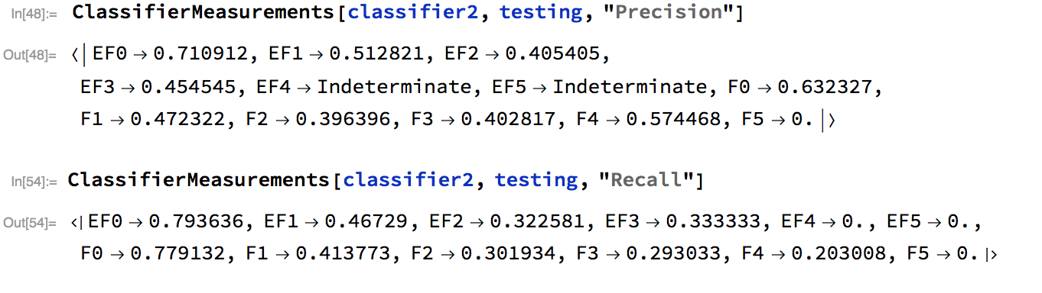
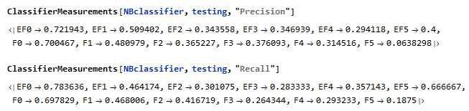
Evaluations
DECISION TREE | NEURAL NETWORK | NAÏVE BAYES
{"EF0",Precision}:0.700909 {"EF0“,Recall}:0.299091 {"F3“,Precision}:0.215164 {"F3",Recall}:0.784836 Accuracy Achieved = 54.4838% | Accuracy = 56.0764% | Accuracy = 56%

